Slide 1

DEPARTMENT OF ARTIFICIAL INTELLIGENCE AND DATA SCIENCE
Vision
To impart international quality education, promote collaborative research and graduate industry-ready engineers in the domain of Artificial Intelligence and Data Science to serve the society.

Slide 2
UNIT II LINEAR STRUCTURES 9
List ADT – array-based implementations –
linked list implementations – singly linked lists – circularly linked lists – doubly linked lists – applications of lists –
Stack ADT – Queue ADT – double ended queues
CO2: design, implement, and analyse linear data structures, such as lists, queues, and stacks, according to the needs of different applications

Slide 3
LINEAR DATA STRUCTURES
The elements are accessed in a sequential order irrespective of whether data items are contiguous or non-contiguous
Ex: array, linked list, stack, queue

Slide 4

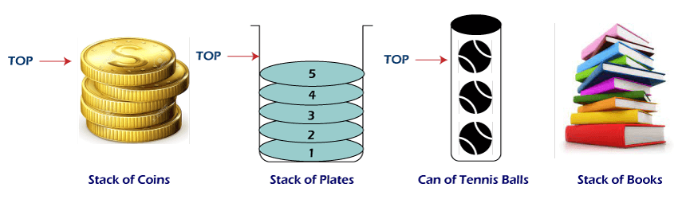

List ADT or Linear data structure
The elements are accessed in a sequential order irrespective of whether data items are contiguous or non-contiguous
Array
Linked list
Stack
Queue
A
0
1
2
i
n
Queue
Stack

Slide 5
Application of array
storing a sequence of high score entries for a video game.
Online ticket booking.
Contacts on a cell phone.
2D arrays(matrices) are used in image processing.
It is also used in speech processing, in which each speech signal is an array.
screen is a multidimensional array of pixels.

Slide 6
Python’s Sequence Types
sequence classes,
list
tuple
str
each supports indexing to access an individual element of a sequence,
syntax such as seq[k]
each uses a low-level concept known as an array to represent the sequence.

Slide 7


Low-Level Arrays
A representation of a portion of a computer’s memory, with individual bytes labeled with consecutive memory addresses
asymptotic analysis, any individual byte of memory can be stored or retrieved in O(1) time
Array
A group of related items can be stored one after another in a contiguous portion of the computer’s memory called array.
Address of cell 4= start + cellsize *index.
2146+2 · 4 = 2146+8 = 2154

Slide 8
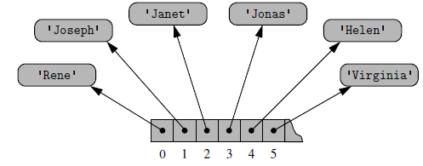
Referential Arrays
Python represents a list or tuple instance using an internal storage mechanism of an array of object references
T= [ Rene , Joseph , Janet , Jonas , Helen , Virginia ]
T

Slide 9
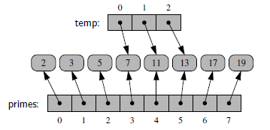
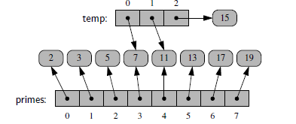
It is possible for a single object to be an element of two or more lists, as those lists store references back to that object.
prime= [2,3,5,7,11,13,17,19 ]
temp = primes[3:6].
temp[2] = 15

Slide 10
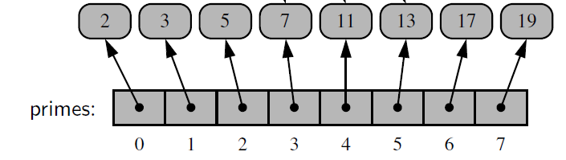
shallow copy
making a new list as a copy of an existing one
prime= [2,3,5,7,11,13,17,19 ]
backup = list(primes)
deep copy
A deep copy create a new list with new elements if the contents of the list were of a mutable type.
the copy function creates a shallow copy of its argument, and the deepcopy function creates a deep copy of its argument.
palette = copy.deepcopy(primes)
backup
palette

Slide 11
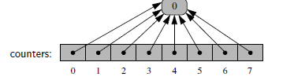
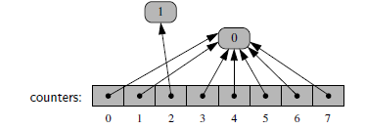
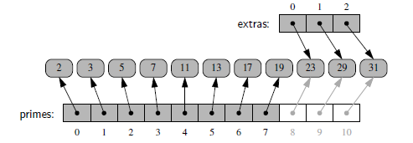
counters = [0]* 8.
counters[2] += 1
#Extending a List
primes.extend(extras)

Slide 12


Compact Arrays in Python
Strings are represented using an array of characters (not an array of references). It will referred as a compact array.
In this, the array is storing the bits that represent the primary data. The type code determine precisely how many bits are needed per element of the array
primes = array( ‘I’ , [2, 3, 5, 7, 11, 13, 17, 19])
Advantage of compact array over referential array
the overall memory usage will be much lower for a compact structure
a referential structure will use 64-bits for the memory address stored in the array
Unicode character stored in a compact array within a string typically requires 2 bytes(16bits)

Slide 13
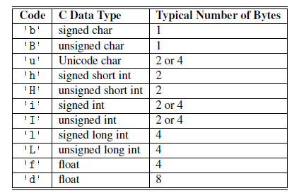
Type code supported by array module

Slide 14
Dynamic array and Amortization
A dynamic array is similar to an array, its size can be dynamically modified at runtime.
EX: list
#Create an empty list, named list1
list1 = [] # size 0, Increase the size
list1 =[2, 4, 6] # size 3, Increase the size
list1.append(‘AI&DS') # size 4, Increase the size
list1.pop() #size 3, reduce the size
Amortization
It is the process of reducing the estimated or nominal value of either an intangible asset,

Slide 15
Program to list’s length and its underlying size
import sys # provides getsizeof function
data = [ ]
for k in range(n):
a = len(data) # number of elements
b = sys.getsizeof(data) # actual size in bytes
print((a, b))
data.append(None)

Slide 16
Implementing a Dynamic Array
class DynamicArray(object):
def __init__(self): #Create an empty array
self.n = 0 # count actual elements
self.capacity = 1 # default array capacity
self.A = self.make_array(self.capacity)
# low-level array
def __len__(self):
return self.n #Return number of elements stored in the array

Slide 17
def append(self, ele): #Add object to end of the array
if self.n == self.capacity: # not enough room
self._resize(2 * self.capacity) # so double capacity
self.A[self.n] = ele
self.n += 1
Append has constant time complexity i.e.,O(1). Extend has time complexity of O(k). Where k is the length of list which need to be added.
A=[10]
A=[10,20]
A=[10,20,4]
my_list = ['geeks', 'for']
another_list = [6, 0, 4, 1]
my_list.extend(another_list)
print my_list

Slide 18
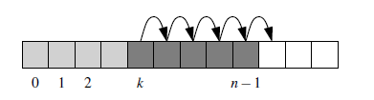
def insertAt(self,item,index):
if index<0 or index>self.n:
print("please enter appropriate index..")
return
if self.n==self.capacity:
self._resize(2*self.capacity)
for i in range(self.n-1,index-1,-1):
self.A[i+1]=self.A[i]
self.A[index]=item
self.n+=1
A=[10,20,4]
Insert(35,2)
A=[10,20,35,4]
Time Complexity of Insert Operation: O(n) [In the worst case all elements may have to be moved]

Slide 19
Case 1: insert data at the beginning of a list,
for n in range(N):
data.insert(0, 22)
Case 2: insert near the middle of a list,
for n in range(N):
data.insert(n // 2, None)
Case 3: insert at the end of the list,
for n in range(N):
data.insert(n, 3)
Ω(n) time
Ω(n/2) time
O(1) time

Slide 20
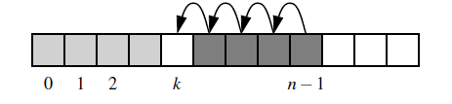
The efficiency of this pop(k) operation is O(n−k),
shifting all subsequent elements leftward to fill the
gap that results from the removal
pop(0) is the most expensive call, using Ω(n) time
def removeAt(self,index):
if self.n==0:
print("Array is empty deletion not Possible")
return
if index<0 or index>=self.n:
return IndexError("Index out of bound....deletion not possible")
# remove element at the end of the list
if index==self.n-1:
self.A[index]=0
self.n-=1
return
# remove at the specific location
for i in range(index,self.n-1):
self.A[i]=self.A[i+1]
self.A[self.n-1]=0
self.n-=1
A=[10,20,4]
remove(,2)
A=[10,20,4]
there is no “efficient” case for remove; every call requires Ω(n) time.
One part of the process searches from the beginning until finding the value at index k, while the rest iterates from k to the end in order to shift elements leftward

Slide 21
def _resize(self, new_cap): # nonpublic utitity
B = self.make_array(new_cap) # new array
for k in range(self.n): #Copy the elements from old array to new array
B[k] = self.A[k]
self.A = B # copy the element of new array to old array
self.capacity = new_cap

Slide 22
def insertionSort(arr): Time complexity best case O(n)
worst case n*(n-1) ~ n²
for i in range(1, len(arr)): # Traverse through 1 to len(arr)
cur= arr[i]
# Move elements of arr[0..i-1], that are greater than cur, to one position ahead of their current position
j = i-1
while j >=0 and cur < arr[j] :
arr[j+1] = arr[j]
j -= 1
arr[j+1] = cur
arr = [12, 11, 13, 5, 6]
insertionSort(arr)
print ("Sorted array is:")
for i in range(len(arr)):
print ("%d" %arr[i])
arr = [12, 11, 13, 5, 6] cur=11,i=1, j=0
arr = [11, 12, 13, 5, 6] cur=13, i=2,j=1
arr = [11, 12, 13, 5, 6] cur=5, i=3, j=2
arr = [11, 12, 5, 13, 6] cur=5, i=3, j= 1
arr = [11, 5, 12, 13, 6] cur=5, i=3, j= 0
arr = [5, 11, 12, 13, 6] cur=5, i=3, j= -1
arr = [5, 11, 12, 13, 6] cur=6, i=4, j=3
arr = [5, 11, 12, 6, 13] cur=6, i=4, j= 2
arr = [5, 11, 6, 12, 13] cur=6, i=4, j= 1
arr = [5, 6, 11, 12, 13] cur=6, i=4, j= 0
arr = [5, 6, 11, 12, 13] cur=6, i=4, j= -1

Slide 23
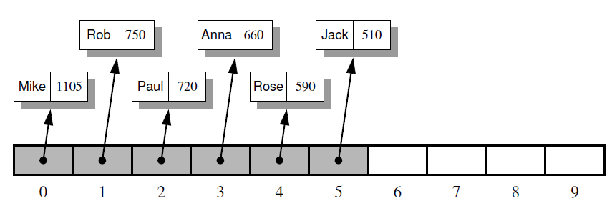
Storing High Scores for a Game
Application of Array
storing a sequence of high score entries for a video game

Slide 24
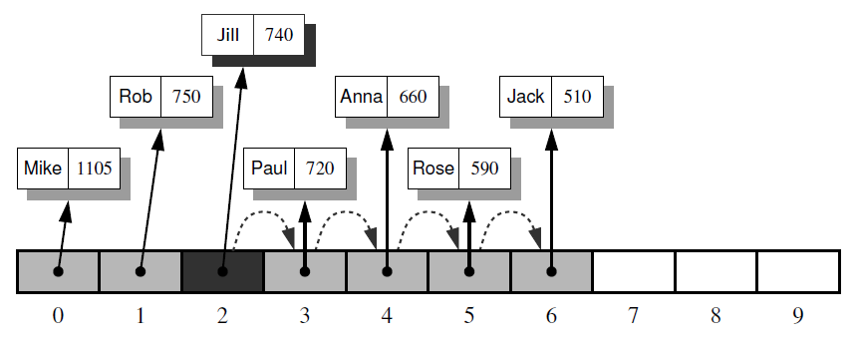
Adding a new GameEntry for Jill to the scoreboard.
In order to make room for the new reference, we have to shift the references for game entries with smaller scores than the new one to the right by one cell. Then we can insert the new entry with index 2.

Slide 25
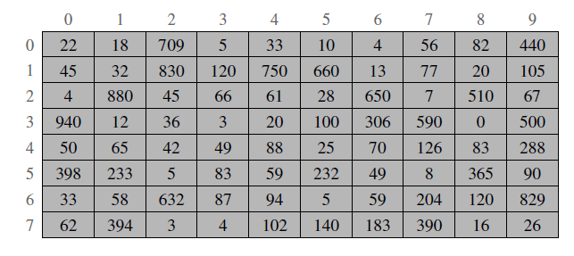
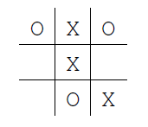
Multidimensional Data Sets
A two-dimensional array is sometimes also called a matrix. We may use two indices, say i and j, to refer to the cells in the matrix. The first index usually refers to a row number and the second to a column number.
Applications
Geographic information represented in two dimensions,
medical imaging provide three-dimensional scans of a patient,
independent financial measures can be modeled as multidimensional data
Ex: Two-Dimensional Arrays and Positional Games: Tic-Tac-Toe

Slide 26

Python’s String Class
Strings are arrays of bytes representing Unicode characters. However, Python does not have a character data type, a single character is simply a string with a length of 1.
Accessing characters in Python
In Python, individual characters of a String can be accessed by using Index.
String1 = "GeeksForGeeks"
# Printing First character
print("\nFirst character of String is: ")
print(String1[0])
# Printing Last character
print("\nLast character of String is: ")
print(String1[-1])

Slide 27
# Python Program to demonstrate String slicing
# Creating a String
String1 = "GeeksForGeeks"
print("Initial String: ")
print(String1)
# Printing 3rd to 12th character
print("\nSlicing characters from 3-12: ")
print(String1[3:12])
# Printing characters between
# 3rd and 2nd last character
print("\nSlicing characters between " +
"3rd and 2nd last character: ")
print(String1[3:-2])
Slicing characters from 3-12:
ksForGeek
Slicing characters between 3rd and 2nd last character:
ksForGee

Slide 28
Deleting/Updating from a String
In Python, Updation or deletion of characters from a String is not allowed. This is because Strings are immutable.
Although deletion of the entire String is possible with the use of a built-in del keyword.
Only new strings can be reassigned to the same name.
String1 = "Hello, I'm a RITANS"
print("Initial String: ")
print(String1)
# Updating a character of the String
String1[2] = ‘p’
print(String1)
del String1[2]
# Deleting a String with the use of del
del String1
TypeError: ‘str’ object does not support item assignment
TypeError: ‘str’ object doesn’t support item deletion

Slide 29
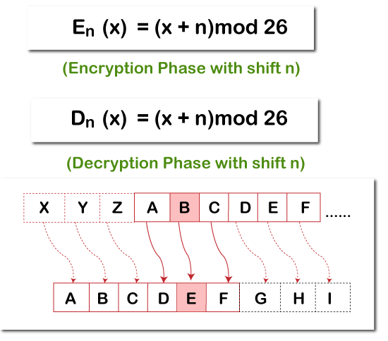
Application of strings and lists
cryptography, the science of secret messages.
encryption, which takes a message, called the plaintext, and converts it into a scrambled message, called the ciphertext.
Decryption, which takes a ciphertext and turns it back into its original plaintext
Plaintext Shift by 3
CAB
FDE
ciphertext

Slide 30
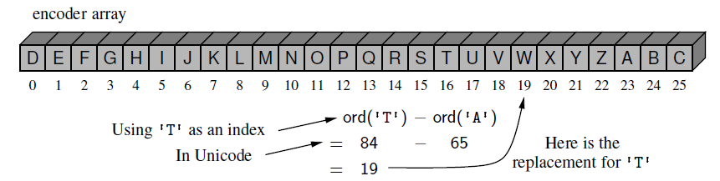
encoder[k] = chr((k + shift) % 26 + ord('A'))
LOVE
(11 ,14 ,21 , 4)
['A', 'B', 'C‘,'D', 'E', 'F', 'G', 'H', 'I', 'J', 'K', 'L', 'M', 'N', 'O', 'P', 'Q', 'R', 'S', 'T', 'U', 'V', 'W', 'X', 'Y', 'Z']
['D', 'E', 'F', 'G', 'H', 'I', 'J', 'K', 'L', 'M', 'N', 'O', 'P', 'Q', 'R', 'S', 'T', 'U', 'V', 'W', 'X', 'Y', 'Z', 'A', 'B', 'C']
['A', 'B', 'C‘,'D', 'E', 'F', 'G', 'H', 'I', 'J', 'K', 'L', 'M', 'N', 'O', 'P', 'Q', 'R', 'S', 'T', 'U', 'V', 'W', 'X', 'Y', 'Z']
['X', 'Y', 'Z', 'A', 'B', 'C', 'D', 'E', 'F', 'G', 'H', 'I', 'J', 'K', 'L', 'M', 'N', 'O', 'P', 'Q', 'R', 'S', 'T', 'U', 'V', 'W']
ORYH
(14 ,17, 24, 7)
decoder[k] = chr((k - shift) % 26 + ord('A'))

Slide 31
class CaesarCipher:
"""Class for doing encryption and decryption using a Caesar cipher."""
def __init__(self, shift):
"""Construct Caesar cipher using given integer shift for rotation."""
encoder = [None] * 26 # temp array for encryption
decoder = [None] * 26 # temp array for decryption
for k in range(26):
encoder[k] = chr((k + shift) % 26 + ord('A'))
decoder[k] = chr((k - shift) % 26 + ord('A'))
self._forward = ''.join(encoder) # will store as string
self._backward = ''.join(decoder) # since fixed

Slide 32
def encrypt(self, message):
"""Return string representing encripted message."""
return self._transform(message, self._forward)
def decrypt(self, secret):
"""Return decrypted message given encrypted secret."""
return self._transform(secret, self._backward)
def _transform(self, original, code):
"""Utility to perform transformation based on given code string."""
msg = list(original)
for k in range(len(msg)):
if msg[k].isupper():
j = ord(msg[k]) - ord('A') # index from 0 to 25
msg[k] = code[j] # replace this character
return ''.join(msg)

Slide 33
if __name__ == '__main__':
cipher = CaesarCipher(3)
message = "LOVE"
#message = "THE EAGLE IS IN PLAY; MEET AT JOE'S."
coded = cipher.encrypt(message)
print('Secret: ', coded)
answer = cipher.decrypt(coded)
print('Message:', answer)
Secret: ORYH.
Message: LOVE
Time complexity
O(n) where n is the size of the given string. Here we traverse the whole string char by char and change the current character in constant time

Slide 34
Pattern matching : Ex: brute-force algorithm
In Pattern matching, search() method searches the string it is passed for any matches.
def search(pat, txt):
M = len(pat)
N = len(txt)
for i in range(N - M + 1): # A loop to slide pat[] one by one */
j = 0
while(j < M) and txt[i+j]==pat[j]: # For current index i, check for pattern match */
j += 1
if (j == M):
print("Pattern found at index ", i)
# Driver Code
if __name__ == '__main__':
txt = "AABAACAADAABAAABAA"
pat = "AABA"
search(pat, txt)
runs in O(mn) time case, because we consider the n−m+1 possible starting indices for the pattern, and we spend O(m) time at each starting position, checking if the pattern matches

Slide 35

Composing Strings
It compose a set of character through repeated concatenation,
letters = ‘ ‘ # start with empty string
for c in document:
if c.isalpha( ):
letters += c # concatenate alphabetic character
sum 1+2+3+· · ·+n times need to run, and therefore time
Optimized code
temp = [ ] # start with empty list
for c in document:
if c.isalpha( ):
temp.append(c) # append alphabetic character
letters = .join(temp) # compose overall result
Time complexity - O(n)

Slide 36
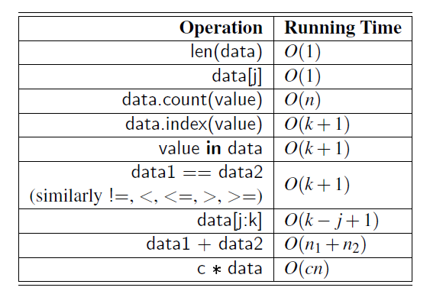
Python’s List and Tuple Classes

Slide 37
References
https://www.geeksforgeeks.org/python-oops-concepts/
Michael T. Goodrich, Roberto Tamassia, and Michael H. Goldwasser, “Data Structures and Algorithms in Python” (An Indian Adaptation), Wiley, 2021

